Slide 1






SMART POTHOLE MANAGEMENT:
A COMPREHENSIVE SYSTEM FOR POTHOLE DETECTION AND PREVENTION

Slide 2


Introduction
About us
Impact
Tech Stacks
Model Overview
System UML Diagrams
Conclusions
Contents

Slide 3


Introduction
Pothole detection technology in cars is an emerging field that uses artificial intelligence (AI) and machine learning to identify road hazards in real time. The process of creating a technology that can spot road hazards such as potholes, broken drains, and manhole covers, and share this data with other vehicles and road authorities. The ultimate aim is to refine this “Pothole Alert” system to the point where it can automatically tweak a car’s suspension to lessen the impact of known road flaws.By tracking the movement of the vehicle and changes in the suspension height, the car can continually adjust its suspension characteristics, offering passengers a smoother ride over bumpy and damaged road surfaces. The data collected from vehicle sensors not only enhances the comfort of the ride for the customers but also has immense potential to be converted into ‘big data’. This data can be shared for the benefit of other road users. It can provide valuable insights into road conditions, traffic patterns, and potential hazards, contributing to safer and more efficient road networks. This is a great example of how technology can be leveraged for societal benefit. The implementation of a comprehensive pothole detection and prevention system could indeed result in significant cost savings. By detecting potholes early and addressing them promptly, we can prevent extensive vehicle damage that often costs billions of dollars to repair. Additionally, this system can make road repairs more effective by providing precise locations and information about the potholes, allowing for targeted and efficient repair work. This not only saves money but also enhances road safety for everyone. Integrating the pothole detection system with a car’s heads-up display (HUD) could provide real-time visual alerts to drivers. The HUD could highlight areas of the road with potholes, allowing drivers to avoid those patches. Moreover, if the detected pothole’s depth is greater than the vehicle’s ground clearance, the system could issue a hazard alert. This would significantly enhance road safety by giving drivers the information they need to navigate safely and prevent potential damage to their vehicles.

Slide 4




About Us
I am Subham Mudi a final year undergraduate student pursuing B.tech in Computer Science and Engineering from Institute of Engineering and Management, Kolkata.
LinkedIn:subham-m-352b1620a

Slide 5

Problem Statement
Potholes are a significant issue in many cities around the world, turning streets into potential death traps. They pose a serious risk to all road users, including drivers, cyclists, and pedestrians. The presence of potholes can lead to accidents, vehicle damage, and even fatalities. Despite efforts to repair these road defects, the problem persists due to factors such as inadequate detection methods, delayed repair processes, and lack of preventive measures. There is a pressing need for a comprehensive solution that not only detects potholes swiftly and accurately but also aids in their prevention and timely repair. This project aims to address this critical urban issue and contribute to safer and better-quality roads

Slide 6

Likely Impact
Prevention of Accidents: Potholes are a major cause of road accidents125. By detecting potholes in real-time, these systems allow drivers enough time to slow down and avoid danger3, thereby reducing the risk of accidents.
Vehicle Maintenance: Potholes can cause various types of damage to vehicles, such as flat tires, damage to the wheel, and impact on the body and interior of the vehicle1. By alerting drivers to the presence of potholes, these systems can help prevent such damage, reducing the need for costly repairs.
Improvement of Road Conditions: The data collected by these systems can be used by road management systems for the timely and effective detection of potholes. This can aid in planning and prioritizing road repair and maintenance, leading to improved road conditions.
Enhancement of Driving Experience: By enabling drivers to avoid potholes, these systems can make driving safer and more comfortable.
Adjustment of Vehicle Settings: Some systems can also adjust suspension settings to dilute the impact of potholes, further protecting the vehicle and enhancing the driving experience.

Slide 7




TECH STACK
PYTHON - VS CODE
SSD (Single Shot MultiBox Detector) - object detection
OpenCV - taking images and pothole detection
CSV, Numpy, Pandas, datetime etc.- other purposes.

Slide 8
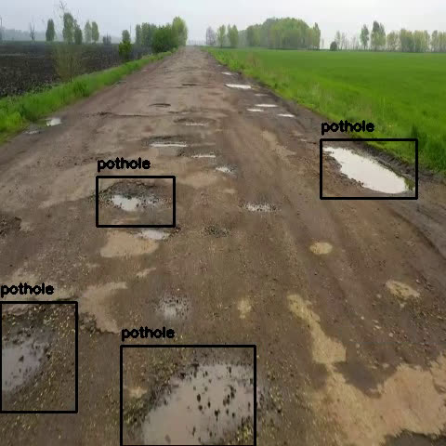
MACHINE LEARNING MODEL
OUTPUT

Slide 9
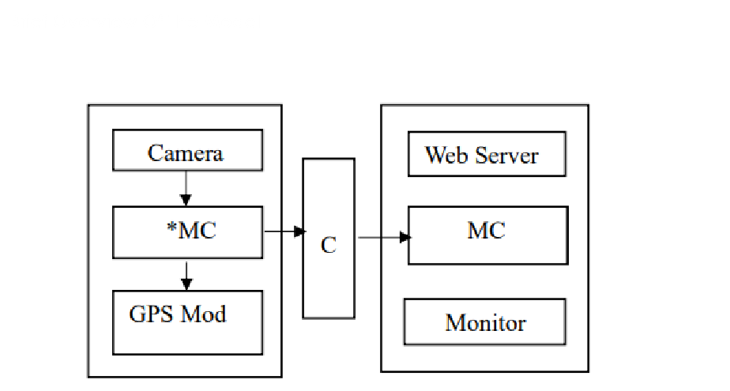
MODEL OVERVIEW

Slide 10
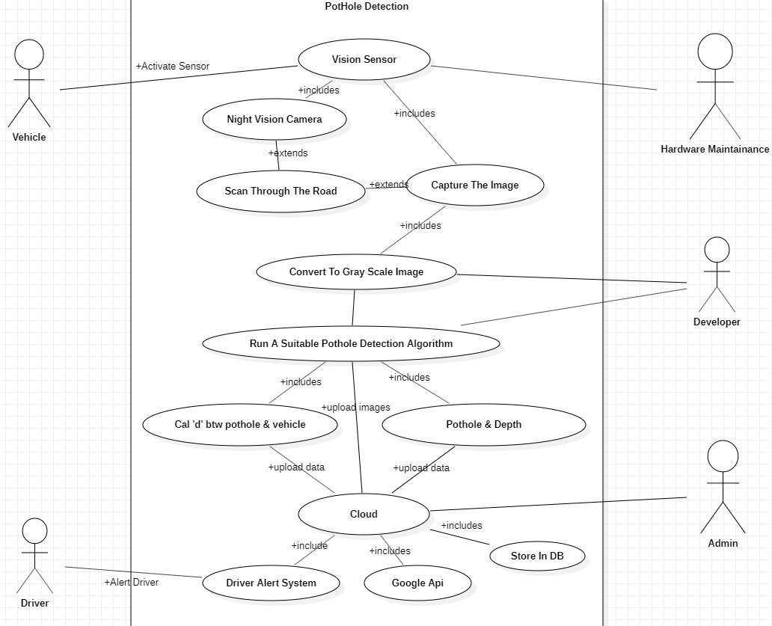
SYSTEM UML DIAGRAMS
Use case Diagram

Slide 11
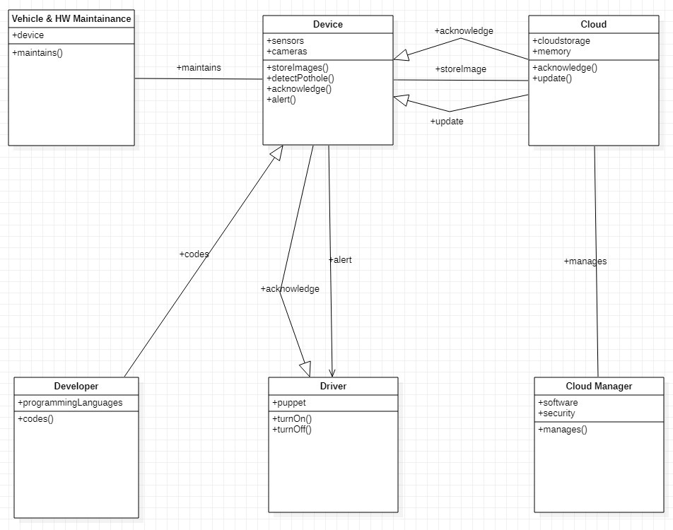
CLASS DIAGRAM

Slide 12
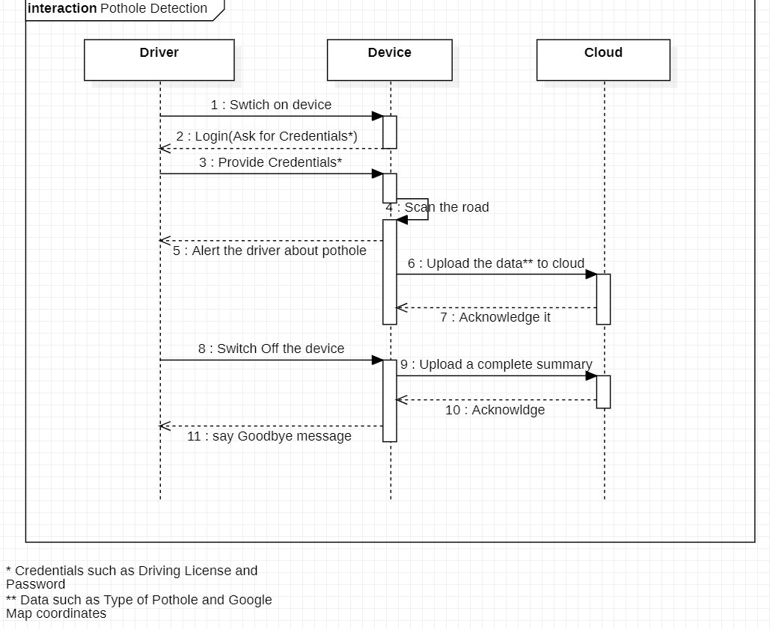
SEQUENCE DIAGRAM

Slide 13
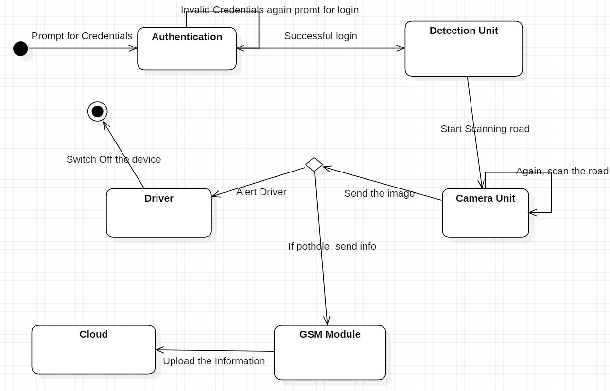
STATE DIAGRAM

Slide 14
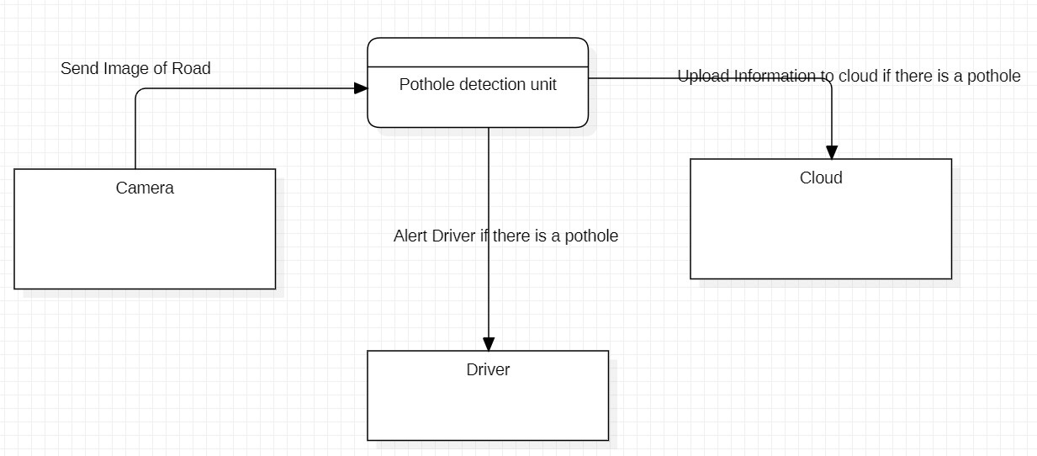
LEVEL 0 DATAFLOW DIAGRAM

Slide 15
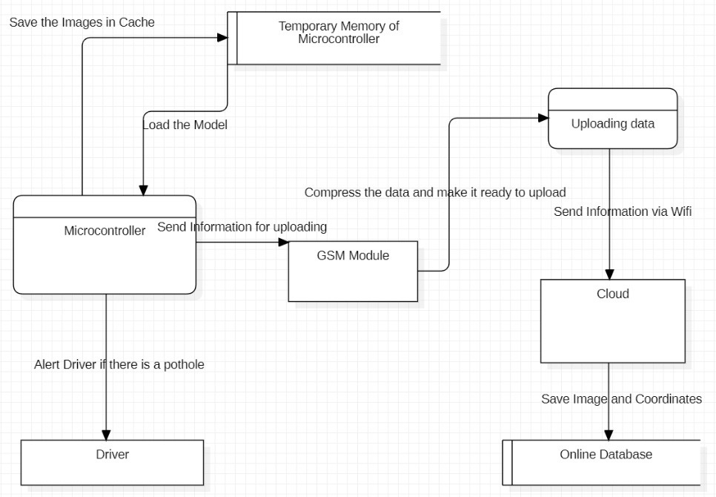
LEVEL 1 DATAFLOW DIAGRAM

Slide 16
Risk Management
Risks
The hardware risks which the device faces is external accidents/shocks, which are unpredictables example:
• Someone hitting it
• Snow covering the lens
• The camera being covered by some object(paper).
• Rainwater going into the circuits and frying them.
And the some of the software risks are privacy and security of data. Time to time updates about the potholes to the cloud and intimate the driver about it correctly . The data should be transmitted only in a secure environment.

Slide 17
Conclusion
Challenges
The challenges in front are, the budget as we cant take that to a high budget model so that it can be used by many and should get a high pixel camera with a low budget and the model should not make false interpretations of the pothole and make the user feel sure about this model.
Possible Extensions
There could be even more possibilities of extending the model to a state at which it not only detects the potholes but also detecting the fixed potholes and updating the earlier data and detecting speed breakers where the drivers need to slow down. Another extension that we can make is to estimate the depth of the pothole and to categorize them to a different different level of danger and alert the driver about that danger, whether he can travel on that road or not. And can be notified to higher officials for the fixing of these potholes.
• To make it budget-friendly.
• Reduce the latency between the uploads.
• Detect potholes even when the car is at a very high speed.

Slide 18

The work can be found at
kaggle
https://github.com/AMiREAL002/Smart-Pothole-Management-A-Comprehensive-System-for-Pothole-Detection-and-Prevention

